Slide 1
Data Visualization
UNIT V
TYBSC IT SEM VI
PROF. ARTI GAVAS
ANNA LEELA COLLEGE OF COMMERCE AND ECONOMICS,
SHOBHA JAYARAM SHETTY COLLGE FOR BMS, KURLA

Slide 2
GIS and maps
There is a strong relationship between maps and GIS.
Map can answer 3 questions:
Where?
  Where do I find KURLA?
  Where did ALSJ’s students come from?
What?
  What is the predominant land use in Airoli?
When?
  When did the Netherlands have its longest coastline

Slide 3
Simplification and abstraction from reality
A map simplifies by leaving out certain details, but at the same time it puts the remaining information in a clear perspective
For e.g. to represent the number of students per country boundaries of countries, and a symbol are sufficient. No need to show cities, mountains, rivers or other phenomena.
Map can be defined as
“a representation or abstraction of geographic reality. A tool for presenting geographic information in a way that is visual, digital or tactile”

Slide 4
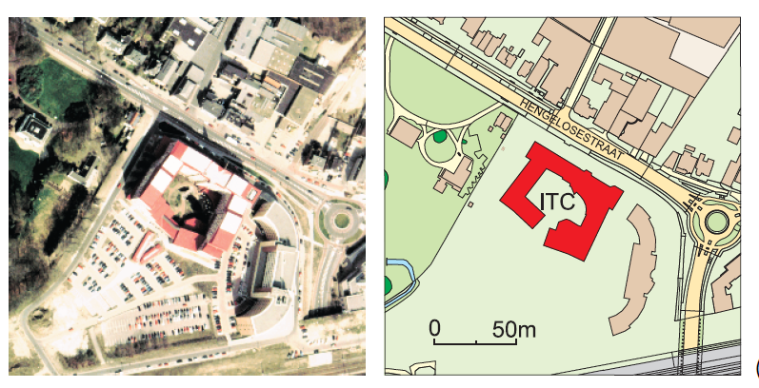
Aerial Photograph
Show all visible objects, including parked cars, and small temporary buildings.
Weather as well as the time of the day influenced its contents: the shadow to the north of the buildings obscures other information.
Map
only gives the outlines of buildings and the streets in the surroundings.
name of the major street

Slide 5
Map & Scale
There is a relationship between the effectiveness of a map for a given purpose and the map’s scale.
The map scale is the ratio between a distance on the map and the corresponding distance in reality.
Maps that show much detail of a small area are called large-scale maps and that of large area are called small scale maps.
Large scale map – map in previous slide
Small scale map – world map

Slide 6
Topographic maps vs thematic maps
A topographic map visualizes, limited by its scale, the Earth’s surface as accurately as possible.
This may include infrastructure (e.g. railroads and roads), land use (e.g. vegetation and built-up area), relief, hydrology, geographic names and a reference grid)
The design of topographic maps is mostly based on conventions. Examples are the use of blue to represent water, green for forests, red for major roads, and black to denote urban or built-up areas -> Cartographic grammar
Thematic maps represent the distribution of particular themes. One can distinguish between socio-economic themes and physical themes.

Slide 7
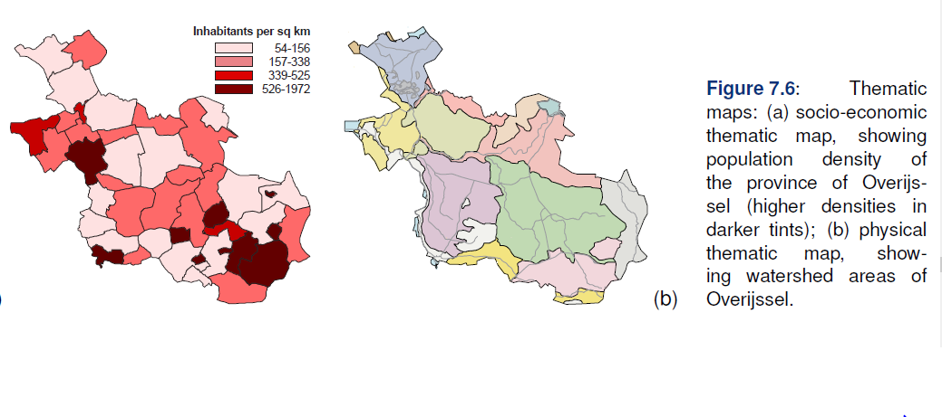

Slide 8
The Visualization Process
Cartographic visualization process is considered to be the translation or conversion of spatial data from a database into graphics
During the visualization process, cartographic methods and techniques are applied
To enable the translation from spatial data into graphics, we assume that the data are available and that the spatial database is well-structured.
The visualization process is always influenced by several factors.
  What will be the scale of the map: large, small?
  Are we dealing with topographic or thematic data?
  quantitative or qualitative nature?

Slide 9
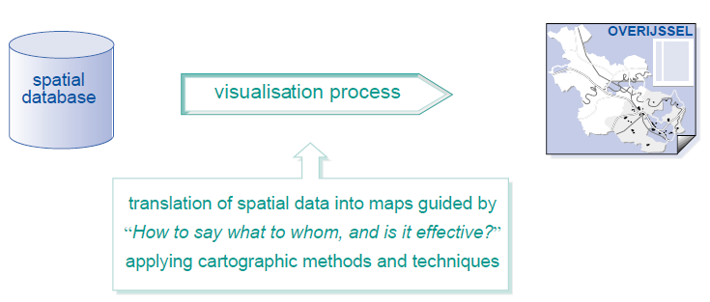
The Visualization Process

Slide 10
Cartographic rules
Cartographers have all kind of tools available to visualize the data.
These tools consist of functions, rules and habits.
Algorithms used to classify the data or to smooth a polyline are examples of functions.
Rules tell us, to use proportional symbols to display absolute quantities.
Habits or conventions or traditions tell us to colour the sea in blue, lowlands in green and mountains in brown.

Slide 11
Visualization strategies
Visual communication: The main function of maps is to communicate geographic information, i.e. to inform the map user about location and nature of geographic phenomena and spatial patterns.
Visual thinking process: Many of these maps are not produced as final products, but rather as intermediaries to support the user in her/his work dealing with spatial data. It is not only a communication tool, but also has become an aid in the user’s (visual) thinking process.
Visual data mining: To deal with huge amount of data
Interactive and dynamic: modern computer technology can facilitate the process of ‘making visible’ in real time

Slide 12
Visualization strategies
Geovisualization: It covers both the presentation and exploration functions of the map
Presentation: is described as ‘public visual communication’ since it concerns maps aimed at a wide audience.
Exploration: is defined as ‘private visual thinking’ because it is often an individual playing with the spatial data to determine its significance.

Slide 13
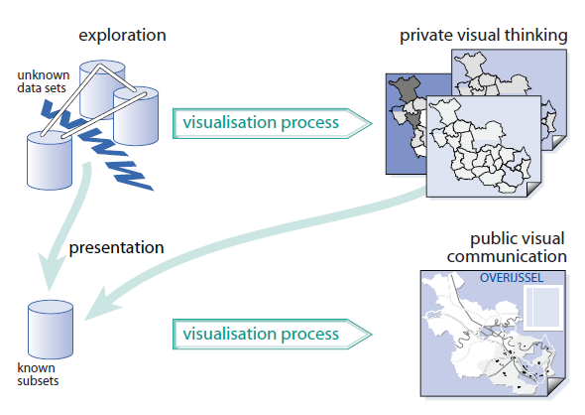

Slide 14
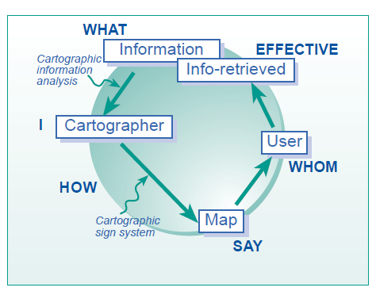
“How do I say what to whom, and is it effective?”
This sentence guides the cartographic visualization process, and summarizes the cartographic communication principle.

Slide 15
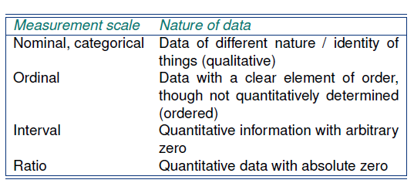
Cartographic data analysis
Data will be of a qualitative or quantitative nature.
Qualitative data is also called nominal or categorical data.
Quantitative data can be measured, either along an interval or ratio scale.

Slide 16
Symbology
Basic elements of a map, irrespective of the medium on which it is displayed, are point symbols, line symbols, area symbols, and text. The appearance of point, line, and area symbols can vary depending on their nature.
In 1967, the French cartographer Bertin developed the basic concepts of the theory of map design
Bertin distinguished six categories, which he called the visual variables and which may be applied to point, line and area symbols.
Visual variables : Size, Value (lightness), Texture, Colour, Orientation and Shape.

Slide 17
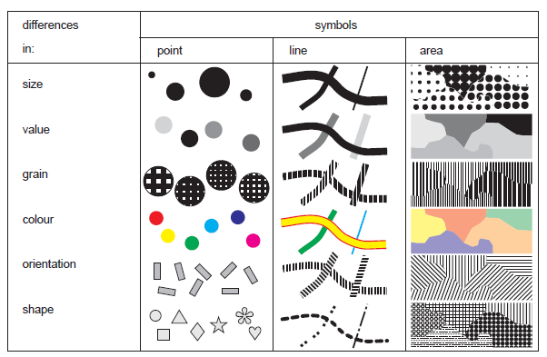

Slide 18
Visual variables
Visual variables influence the map user’s perception in different ways. What is perceived depends on the human capacity to see or perceive:
What is of equal importance (e.g. all red symbols represent danger),
Order (e.g. the population density varies from low to high—represented by light and dark colour tints, respectively),
Quantities (e.g. symbols changing in size with small symbols for small amounts), or
An instant overview of the mapped theme.

Slide 19
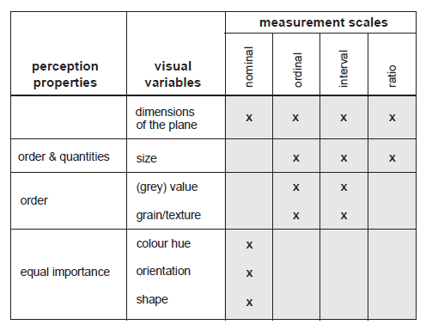

Slide 20
How to map . . . ?
Deals with characteristic mapping problems
Based on cartographic rules and guidelines
How to map qualitative data?
How to map quantitative data?

Slide 21
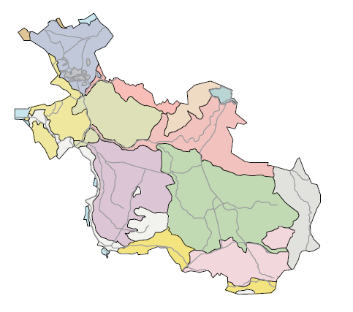
How to map qualitative data? Good Example
Map represents different states in Netherlands with watershed present.
The application of colour would be the best solution since it allows one to quickly differentiate between different geographic units.
However,
since none of the watersheds is more important than the others, the colours used have to be of equal visual weight or brightness.
Map can also be made by filling the watershed areas by different forms (like small circles, squares, triangles, etc.)

Slide 22
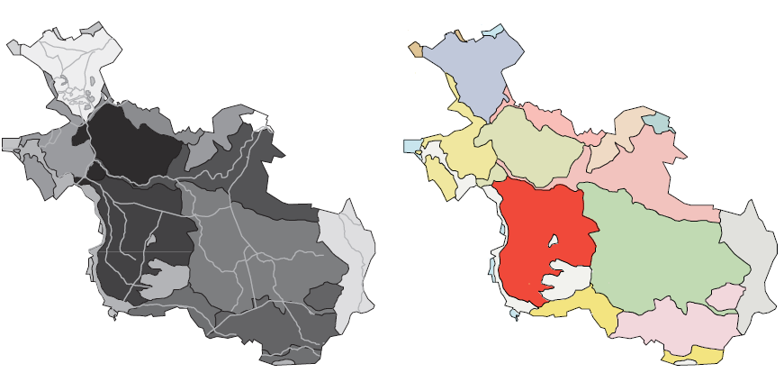
How to map qualitative data? Bad Example
Two examples
of wrongly designed
qualitative maps:
(a) Misuse of tints of black;
(b) misuse of bright colours

Slide 23
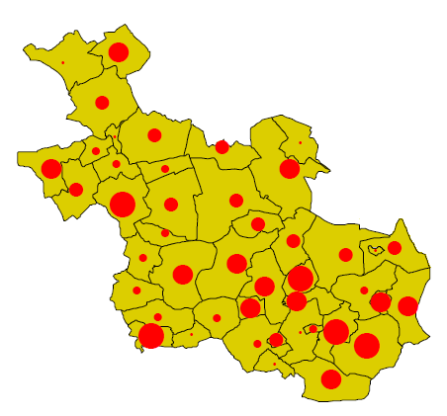
How to map quantitative data? Good Example
Map should allow the user to determine the amount per municipality and also offer an overview of the geographic distribution of the phenomenon.
Symbols varying in size fulfil this demand.

Slide 24
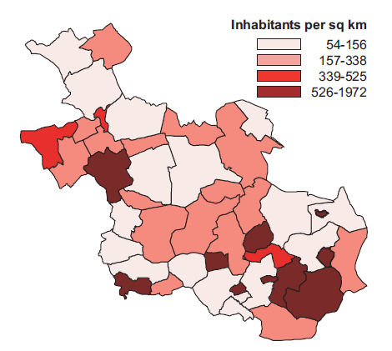
How to map quantitative data? Good Example
Relative Quantitative Data
Numbers now show a clear relation with the area they represent.
Value has been used to display the density from low (light tints) to high (dark tints). The map reader will automatically and in a glance associate the dark colours with high density and the light values with low density.

Slide 25
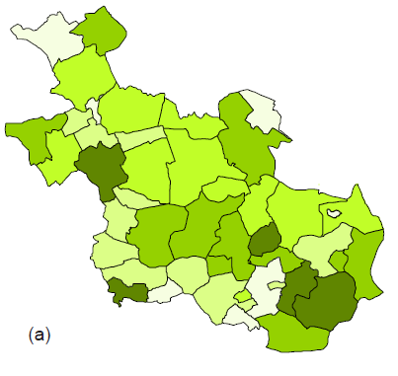
How to map quantitative data? Bad Example
Absolute qualitative data:
Different tints of green have been used to represent absolute population numbers.
The reader might get a reasonable impression of the individual amounts but not of the actual geographic distribution of the population.
Imagine a small and a large unit having the same number of inhabitants. The large unit would visually attract more attention, giving the impression there are more people than in the small unit
wrong use of green tints for absolute population figures

Slide 26
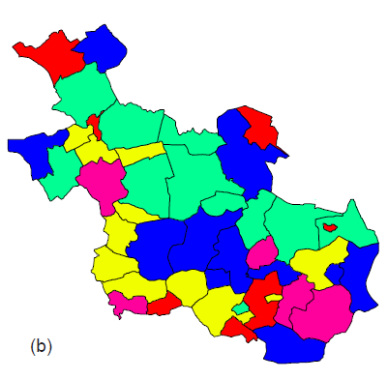
How to map quantitative data? Bad Example
The applied four-colour scheme makes it is impossible to infer whether red represents more populated areas than blue.
It is impossible to instantaneously answer a question like “Where do most people live?”
Incorrect use of colour

Slide 27
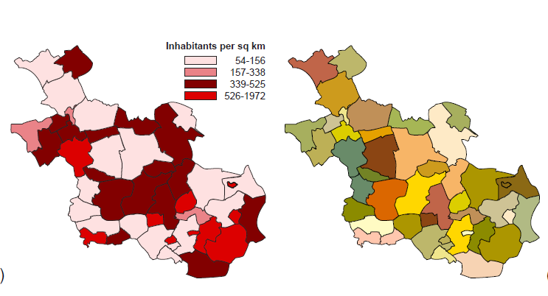
How to map quantitative data? Bad Example
In the first map, the value tints are out of sequence. The user has to go through quite some trouble to find out where in the province the high-density areas can be found. Why should mid-red represent areas with a higher population density than dark-red?
In the second map, multiple colours have been used.

Slide 28
How to map the terrain elevation?
Contour map, in which the lines connect points of equal elevation, is generally used
To visually improve the information content of such a map the space between the contour lines can be filled with colour and value information following a convention, e.g. green for low elevation and brown for high elevation areas.
This technique is known as hypsometric or layer tinting.
Even more advanced is the addition of shaded relief. This will improve the impression of the three-dimensional relief

Slide 29
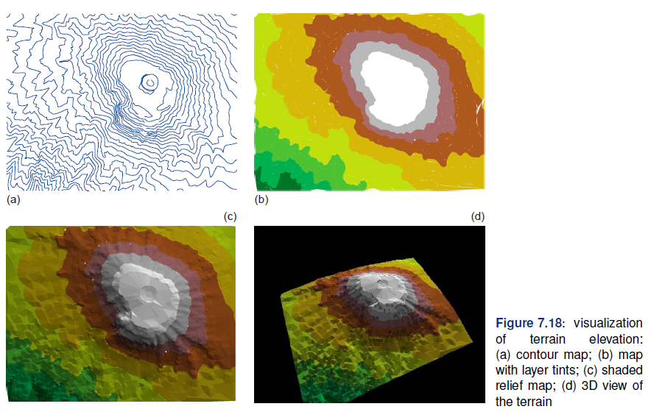

Slide 30
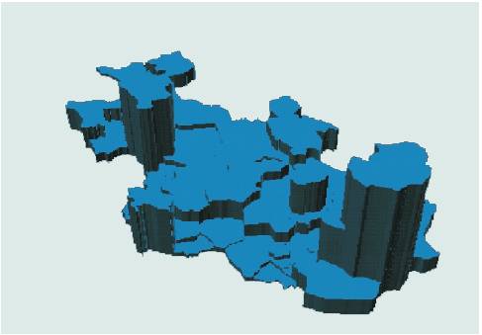
Quantitative data visualized in three dimensions
Socio-economic data can also be viewed in three dimensions. Figure shows the absolute population figures in three dimensions.
The proportional height of each zone indicates total population.
Advances in spatial data handling have not only made the third dimension part of GIS routines.

Slide 31
How to map time series
The handling of time-dependent data is a part of GIS routines.
This has been caused by the increasing availability of data captured at different periods in time.
To analyse changes caused by real world processes single time slice data are no longer sufficient, and the visualization of these processes cannot be supported with only static paper maps
Mapping time means mapping change.
This may be change in a feature’s geometry, in its attributes or both.
Examples of changing geometry are the evolving coastline of the Netherlands, the location of Europe’s changing national boundaries, or the position of weather fronts.
The changes of a land parcel’s owner, land use, or changes in road traffic intensity are examples of changing attributes.
Urban growth is a combination of both.

Slide 32
Using symbology to represent change
Arrows: that have an origin and a destination. They are used to show movement and their size can be an indication of the magnitude of change.
Size changes can also be applied to other point and line symbols to show increase and decrease over time.
Specific point symbols such as ‘crossed swords’ (battle) or ‘lightning’ (riots) can be found to represent dynamics in historic maps.
The use of the visual variable value (expressed as tints).
In a map showing the development of a town, dark tints represent old built-up areas, while new built-up areas are represented by light tints

Slide 33
Temporal cartographic techniques
Single static map: Specific graphic variables and symbols are used to indicate change or represent an event.
Series of static maps: A single map in the series represents a ‘snapshot’ in time. Together, the maps depict a process of change. Change is perceived by the succession of individual maps depicting the situation in successive snapshots. It could be said that the temporal sequence is represented by a spatial sequence, which the user has to follow, to perceive the temporal variation.
Animated map: Change is perceived to happen in a single image by displaying several snapshots after each other just like a video cut with successive frames. The difference with the series of maps is that the variation can be deduced from real ‘change’ in the image itself, not from a spatial sequence

Slide 34
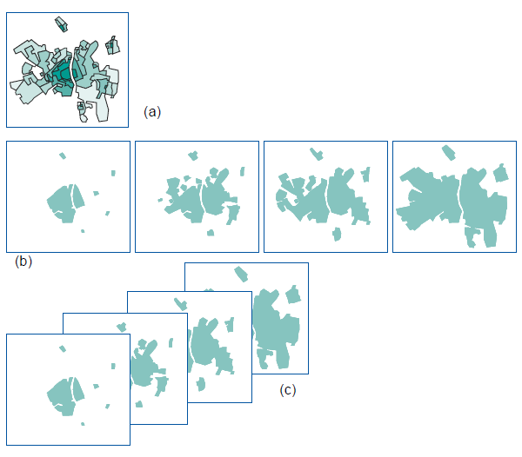

Slide 35
Map cosmetics
Fundamental requirements
  Title: informing the user about the topic visualized
  Legend: to understand how the topic is depicted.
  Additional marginal information: scale indicator, a north arrow for orientation, the map datum and map projection used, and some lineage information (such as data sources, dates of data collection, methods used, etc.).

Slide 36
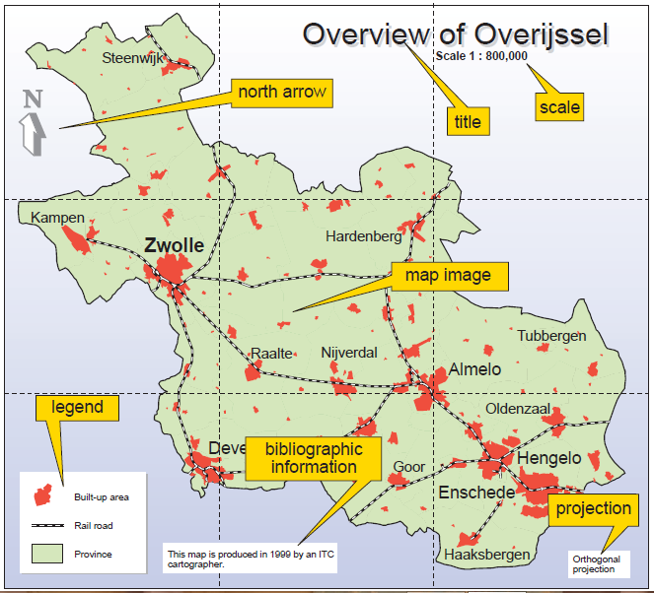

Slide 37
Map dissemination
The map design will not only be influenced by the nature of the data to be mapped or the intended audience but the output medium also plays a role.
Compared to maps on paper, onscreen maps have to be smaller, and therefore their contents should be carefully selected.
Maps and multimedia (photography, sound, video, animation) can be integrated. Pointing to a country on a world map starts the national anthem of the country or shows its flag. It can be used to explore a country’s language; moving the mouse would start a short sentence in the region’s dialects -> Multimedia maps

Slide 38
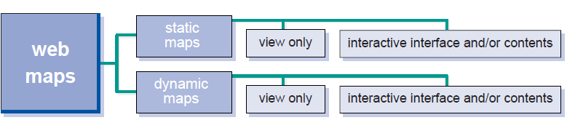
Classification of maps on the WWW
An important distinction is the one between static and dynamic maps.
Many static maps on the web are view-only. Organizations, such as map libraries or tourist information providers, often make their maps available in this way. When static maps offer more than view-only functionality, they may present an interactive view to the user by offering zooming, panning, or hyperlinking to other information.
Dynamic maps are about change; change in one or more of the spatial data components. Clicking on geographic objects may lead the user to quantitative data, photographs, sound or video or other information sources on the Web. The user may also interactively determine the contents of the map, by choosing data layers, and even the visualization parameters, by choosing symbology and colours.
On the WWW, several options to play animations are available. The so-called animated-GIF can be seen as a view-only version of a dynamic map.

Slide 39
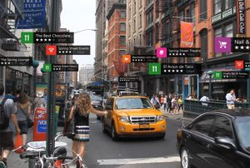
Integration of maps with AR
Location-based, position-based, or GPS based augmented reality, uses a GPS, digital compass, velocity meter, or accelerometer which is embedded in the device to provide data based on your location.
It is most commonly used for mapping directions, finding nearby businesses, and other location-centric mobile applications.

